Slide 1
New Approach to Hospital Seismic Law Protects Communities’ Access to Care
Notes:
As we all know, California is vulnerable to a range of disasters.
Whether it’s a wildfire, flood, mudslide, or an earthquake, California hospitals have to be ready to respond within a moment’s notice.
Hospitals must comply with a host of state and federal laws and regulations governing disaster preparedness – including standards set by the Centers for Medicare & Medicaid Services (CMS) and California’s Title 22 (Code of Regulations), as well as by accrediting organizations such as The Joint Commission.
Every hospital must have a comprehensive Emergency Operations Plan that identifies known & potential risks and outlines appropriate mitigation strategies.
Hospitals also are required to conduct simulation disaster exercises at least twice a year, which helps ensure our staff is well-trained and ready to respond whenever a disaster strikes.

Slide 2
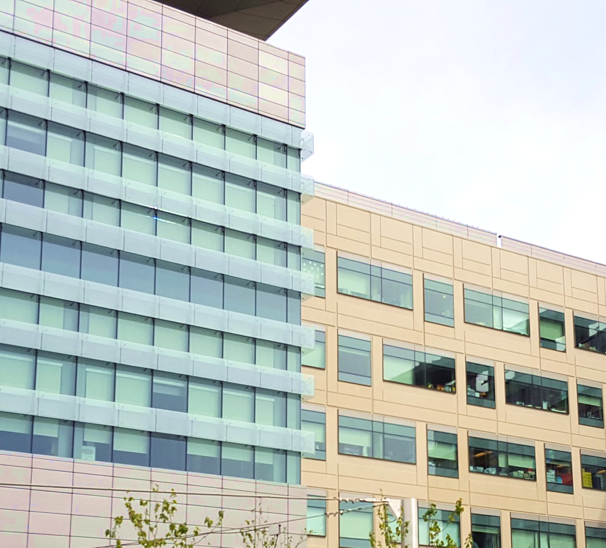
California hospital buildings are among the safest in the world. Decades of work have been invested to upgrade & replace outdated facilities.
Notes:
A state law enacted in 1994 (SB 1953) requires all acute care hospital buildings in California to meet strict earthquake safety standards.
Here at __________ Hospital/Medical Center we have.. INSERT SPECIFIC INFO ON WORK HOSPITAL HAS DONE TO UPGRADE/REPLACE OUTDATED BUILDINGS.

Slide 3
100%
of hospital buildings will be able to withstand a major earthquake by 2025.
This means hospitals will have achieved the highest level of safety possible for patients, employees & visitors alike
Notes:
Throughout the state, hospitals have done similar work − upgrading and replacing outdated facilities.
As a result, 95% of hospital buildings today now meet the state’s life-safety standard − which means they will be able to withstand a major earthquake. Within the next five years, all hospital buildings in California will meet this standard.

Slide 4
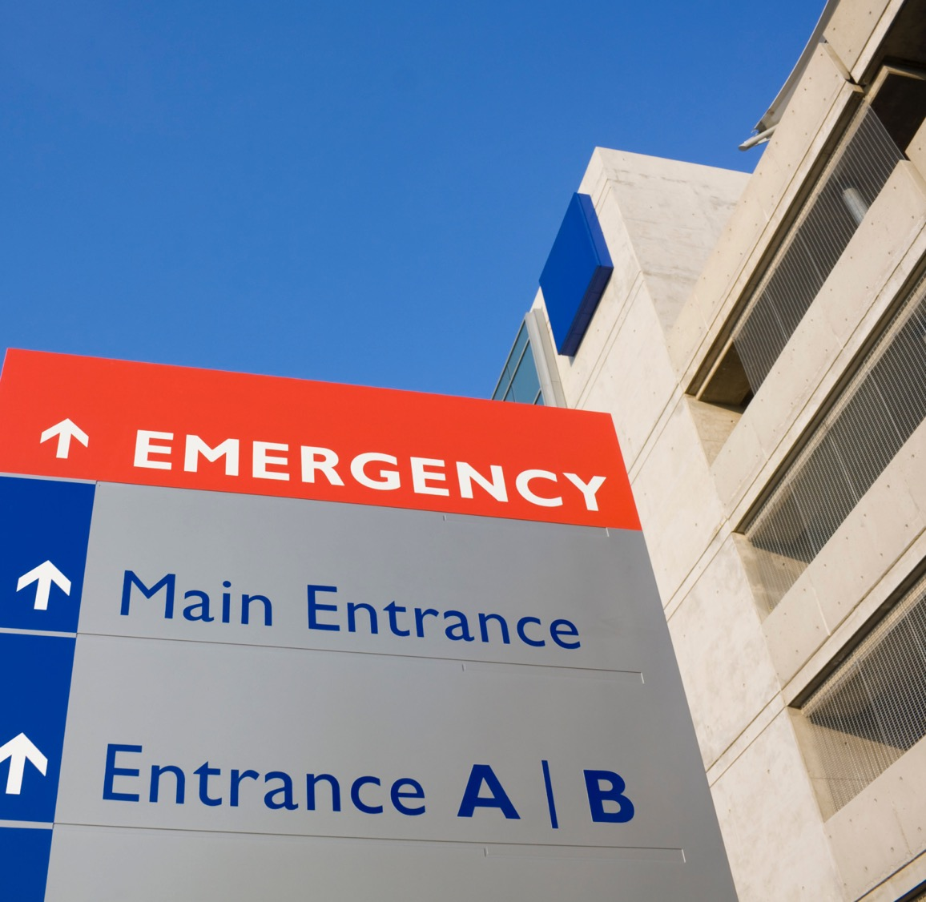
Yet, outdated and onerous state regulations threaten access to care for communities throughout California
Notes:
But the same 1994 law that set safety standards for hospitals also has another mandate – one that is not practical and, if not modified, will force hospitals across the state to close.
Current law requires every single hospital building in the state that provides acute care patient services to be “fully operational” after a major earthquake by January 1, 2030.
If hospitals don’t meet this deadline, they (we) will be forced to close.
Just think about that for a moment.
The very law that is intended to ensure communities have access to care after an earthquake strikes may, in fact, cause our local hospitals to close before the next earthquake occurs.

Slide 5
Where we are SAFETY: California’s hospitals have spent the past 20 years upgrading or replacing outdated buildings - making them among the safest in the world. What’s being asked OPERATIONS: Additional requirements call for hospitals to remain “fully operational” after an earthquake strikes. Hospitals that can’t meet this standard by January 1, 2030 will be forced to close.
Notes:
Hospitals across California have spent the past 20 years ensuring the safety of our facilities. Our buildings are now among the safest in the world.
It’s important to remember, however, that hospitals don’t operate in a vacuum. We are just one component of a community’s interconnected infrastructure − which includes our roads and bridges, water and wastewater services, electricity and fuel, food service and telecommunications.
And when a major earthquake strikes, there is likely to be significant damage throughout the community. Our streets might be impassable, the power lines may be down, buildings and houses may be jolted off their foundations.
While hospitals are already required to have 24 hours worth of back-up power and a plan for access to 96 hours of power, it’s not likely that we will be able fully function after three days if the damage in our broader community is severe.
Thus, requiring all hospitals to be “fully operational” after an earthquake is impractical and unrealistic.

Slide 6
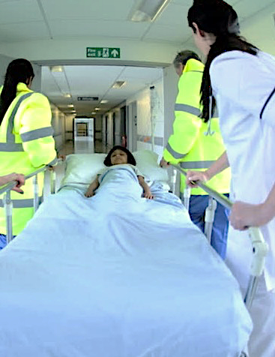
A Reasonable Approach
21st century health care is vastly different than when seismic regulations were passed.
Spending billions on buildings isn’t the only way to ensure access to care.
Emergency care will be provided, without fail, following a disaster.
Notes:
Make no mistake – people who are hurt or become ill after a disaster will still get the care they need when they need it. But we need a more reasonable approach to meeting the state’s hospital seismic requirements. Otherwise, some patients will lose access to care as hospitals in their communities are forced to close.
Simply put − forcing hospitals to spend billons of dollars that could otherwise be used for patient care on hospital buildings that people may not even be able to get to after an earthquake is not in the best interest of patients or communities.

Slide 7
“…seismic construction projects that disrupt service
provision, reduce the types of services that can be
provided, or reduce the overall capacity of the
hospital could have adverse consequences for
communities.” 2019 RAND study on California Seismic Standards
Notes:
The RAND Corporation last year issued a comprehensive look at California’s hospital
seismic mandate. This report confirms the enormous cost of meeting the 2030 requirement, estimated to be up to $143 billion. The price tag will be higher when you factor in financing and other costs.
The RAND report suggest that lawmakers may want to consider policy alternatives to the 2030 requirements that will make the best use of limited resources while still ensuring access to care for all Californians.
For example, the report points out that broader community health needs may suffer if hospitals are forced to invest in seismic construction projects that disrupt patient care, reduce the types of services the hospital is able to provide, or reduce the overall capacity of the hospital.
INSERT ADDITIONAL LOCAL DETAILS/COST ESTIMATES IF APPROPRIATE
Here are ___________ Hospital/Medical Center we would have to invest another $________ to meet the 2030 requirements. That is money that could be better spent on improving our ______________

Slide 8
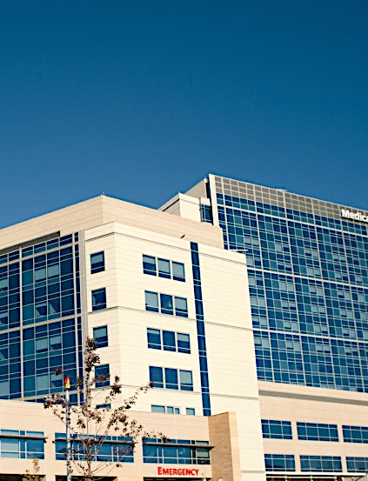
How you can help
Support SB 758 (Portantino), which would refocus the “fully operational” standard to the physical areas of the hospital where emergency medical services — including necessary surgical and recovery care — will be provided for 72 hours following an earthquake
Notes:
The California Hospital Association is sponsoring legislation (SB 758) that would refocus the “fully operational” standard to the physical areas of the hospital where emergency medical services — including necessary surgical and recovery care — will be provided for 72 hours following an earthquake

Slide 9
Option slide for member hospitals to customize

