Slide 1
California COVID-19 Vaccine Planning
November 13, 2020
Notes:
Additional points to mention:
We will be reviewing these in batches on a weekly basis starting the Monday after they’re due; important to get your plan in on time.
Feedback report will be provided to LHD by field rep via email, phone, or in person.
Revised plans due 2 calendar weeks after meeting with rep.

Slide 2
Agenda
Vaccine Planning Overview
Allocation Framework
GACH Data Presentation
Vaccine Storage and Handling
Provider Registration
Notes:
Additional points to mention:
We will be reviewing these in batches on a weekly basis starting the Monday after they’re due; important to get your plan in on time.
Feedback report will be provided to LHD by field rep via email, phone, or in person.
Revised plans due 2 calendar weeks after meeting with rep.

Slide 3
Allocation of COVID-19 Vaccine During Scarcity
Notes:
Additional points to mention:
We will be reviewing these in batches on a weekly basis starting the Monday after they’re due; important to get your plan in on time.
Feedback report will be provided to LHD by field rep via email, phone, or in person.
Revised plans due 2 calendar weeks after meeting with rep.

Slide 4
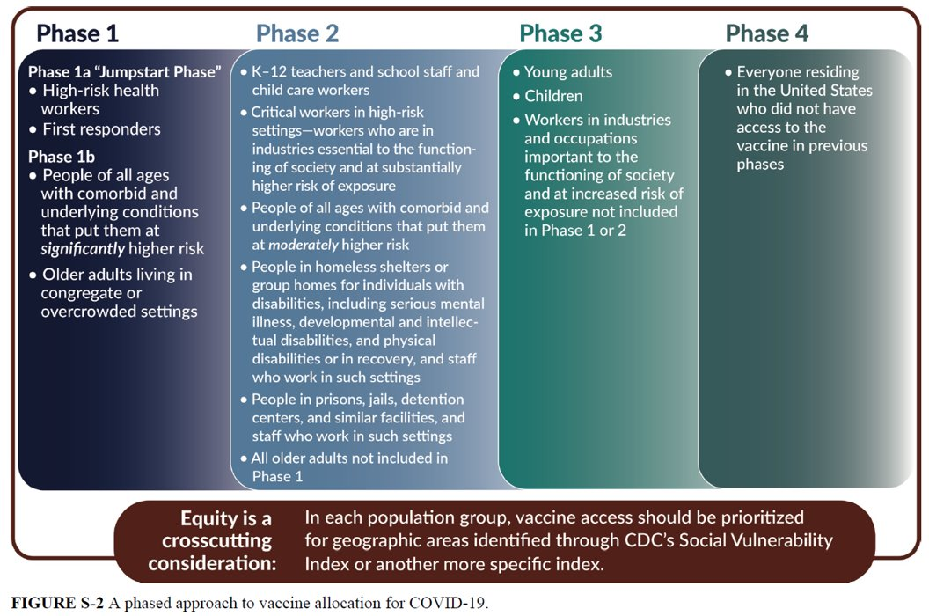
NASEM Prioritization
Notes:
Additional points to mention:
We will be reviewing these in batches on a weekly basis starting the Monday after they’re due; important to get your plan in on time.
Feedback report will be provided to LHD by field rep via email, phone, or in person.
Revised plans due 2 calendar weeks after meeting with rep.

Slide 5
Definition of Healthcare Worker
“Health professionals who are involved in direct patient care, as well as those working in transport, environmental services, or other health care facility services—who risk exposure to bodily fluids or aerosols”
- NASEM
Notes:
Additional points to mention:
We will be reviewing these in batches on a weekly basis starting the Monday after they’re due; important to get your plan in on time.
Feedback report will be provided to LHD by field rep via email, phone, or in person.
Revised plans due 2 calendar weeks after meeting with rep.

Slide 6
Potential Criteria for Ranked Subprioritization Using An Equity Lens
Type of Institution
Attributes of Individual Staff
Location of Institution
Others
Notes:
Additional points to mention:
We will be reviewing these in batches on a weekly basis starting the Monday after they’re due; important to get your plan in on time.
Feedback report will be provided to LHD by field rep via email, phone, or in person.
Revised plans due 2 calendar weeks after meeting with rep.

Slide 7
COVID-19 Vaccine Allocation Data Team
Notes:
Additional points to mention:
We will be reviewing these in batches on a weekly basis starting the Monday after they’re due; important to get your plan in on time.
Feedback report will be provided to LHD by field rep via email, phone, or in person.
Revised plans due 2 calendar weeks after meeting with rep.

Slide 8
Dataset​ | Contains​
Dataset 1: Healthcare Workforce by Individual License​ | Provides summed counts of Healthcare Licensees by Census Region, County, Agency, and License Type for licensed healthcare workers.​ ​
Dataset 2: Healthcare Workforce by Healthcare Facility​ | Estimated healthcare workforce from available sources by facility. ​
Dataset 2.1: Healthcare Workforce by Healthcare Facility with Estimates of Race​ | Estimated healthcare workforce from available sources by facility with estimates of race of healthcare workers.​
Dataset 2A: General Acute Care Hospital Staffing and Capacity from Oct 2020 Capacity Survey​ | Staffing and capacity reported by facility from October 2020 capacity survey. Only for General Acute Care Hospitals.​
Dataset 2A.1: General Acute Care Hospital Staffing and Capacity from Oct 2020 Capacity Survey with Estimates of Race​ | Staffing and capacity reported by facility from October 2020 capacity survey. Only for General Acute Care Hospitals with estimates of race of healthcare workers.​
Dataset 3: Total peace officers​ | Total peace officer staff including dispatchers. CHP numbers provided by CHP HR. Department of Corrections data provided by CDCR HR. All other peace officers pulled fromCommission onPeace Officer Standards and Training.​
Dataset 4: Critical Infrastructure Industries by County​ | Uses first quarter 2020 data from the Quarterly Census of Employment and Wages (QCEW),gathered statewide from all employers eligible for unemployment insurance.​
Dataset 5: Critical Infrastructure Occupations by County​ | Uses Occupational Employment and Statistics and Wages (OES) data, a semiannual survey of workplaces.​
Dataset 6: Vulnerability Index​ | Vulnerability indices combine community characteristics into a single score, or index, to identify communities in need of support.​
Dataset 7: California Incarcerated Populations​ | Includes local jail, state prison, US Prison, and ICE detention incarcerated populations​
Dataset 8: Vulnerable Populations​ | Contains vulnerable population numbers by County​
Dataset 9: LTC Occupants​ | Includes CDPH CHCQ and DSS licensed facilities​

Slide 9
Dataset 2:
Healthcare Workforce by Healthcare Facility

Slide 10
Dataset 2: Licensed Healthcare Workforce by Facility

Slide 11
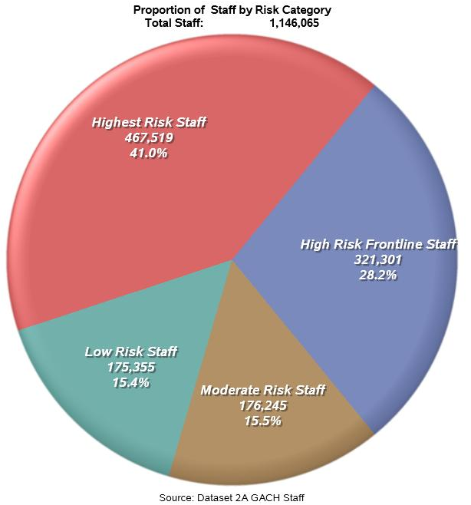
October 2020 Survey of General Acute Care Hospitals --
68.83% of hospital staff were classified as being at highest or high risk of exposure (788,820 health care workers out of 1,146,065 total GACH workforce).

Slide 12
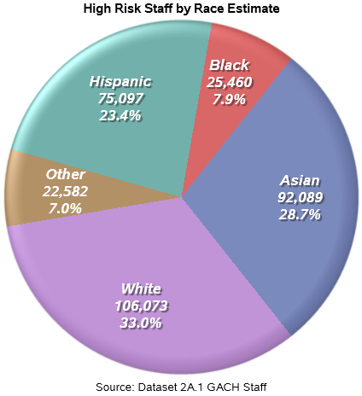
From October 2020 Survey of General Acute Care Hospitals. Survey Results were used to estimate the staff at non-reply GACHs.
Race estimates are estimated from Medical Board and Nursing Board surveys of licensees.

Slide 13
Example of a Vulnerability Index
Most Vulnerable
Del Norte
Fresno
Glenn
Imperial
Kern
Kings
Lake
Madera
Merced
San Bernardino
San Joaquin
Tehama
Tulare
Yuba
Lightest blue = most vulnerable

Slide 14
Storage & Handling
Pfizer & Moderna Vaccines
Notes:
Additional points to mention:
We will be reviewing these in batches on a weekly basis starting the Monday after they’re due; important to get your plan in on time.
Feedback report will be provided to LHD by field rep via email, phone, or in person.
Revised plans due 2 calendar weeks after meeting with rep.

Slide 15
Pfizer Vaccine
Pfizer-BioNTech
mRNA vaccine
2 doses, 21 days apart
Requires ultra-low temperature storage (-80°C)
Shipped from Pfizer to administration/storage sites
May be the first vaccine distributed (~December)

Slide 16
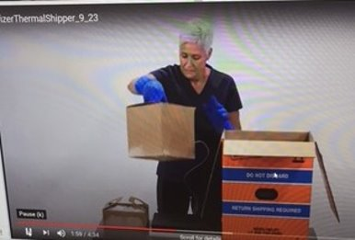
Pfizer Vaccine Packaging
Packaged in Pfizer’s Ultra-Low Temperature Thermal Shipper
Up to five trays (pizza boxes) per shipper
Tray and vial quantities:
One vial = 5 doses
One tray = 195 vials
975 doses per tray: the minimum order
Five trays = 4,875 doses: the maximum per
shipper

Slide 17
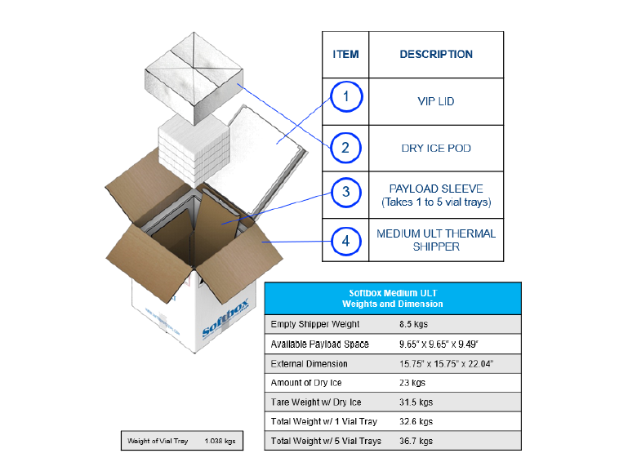
Pfizer Vaccine Packaging
Container + dry ice = 80 lbs
Container dimensions: l 16” x w 16” x h 22”
Trays are 9”x 9” x 2”

Slide 18
Pfizer Vaccine Receipt
Inspect the thermal shipper
Open shipper and check the digital data logger (DDL)
Turn off DDL
Inspect trays/vials for damage and leakage

Slide 19
Storage Options
Store in the shipper
Dry ice distribution may become very complex
Dry ice distribution may prove to be expensive over the months
ULT Freezers
Refrigerate immediately and use in 5 days

Slide 20
Storing in the Shipper
Process
Recharge within 24 hours of receipt
USG will provide
Recharge every 5 days, opening shipper only twice per day
Receiving site needs to provide
Return shipper to Pfizer within 10-20 days
Shipper is recharged with ½" to ¾" dry ice pellets
Add ~22 lbs. of pelletized dry ice per recharge
CDC is working on method for receiving site to continue use of DDL

Slide 21
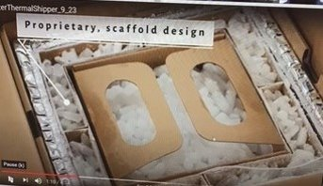
Storing in the Shipper (Cont.)
Dry ice PPE
Dry ice gloves and eye protection
Use a metal scoop

Slide 22
Pfizer Vaccine Fun Facts
Vaccine requires diluent
Normal saline provided by USG
Ancillary supplies provided by USG
Vaccine shelf-life at ULT: ~ 6 months
Vaccine shelf-life at refrigerated temperature, not reconstituted: 120 hours/5 days
Reconstituted vaccine can be left at room temperature for 6 hours
Thaw Times: 3 hours in refrigerator/30 minutes at room temperature

Slide 23
Ordering Limitations
Pfizer may be the only option initially & 975 doses is the smallest order
Pfizer is developing a 125-dose tray, March 2021

Slide 24
Moderna Vaccine
mRNA vaccine
Two doses, 28 days apart
Requires frozen storage (-20° C)
The range (-25° to -15° C) is narrower than other frozen vaccines
Shipped to administration/storage sites from McKesson
Ancillary supplies shipped by USG
Expected to be released closely behind Pfizer

Slide 25
Moderna Shipping/Storage/Use
Shipping and storage temperature: -20°C
Refrigerated Storage: (2°C - 8°C) for 7 days
Multidose vials (10 per/vial)
100 dose minimum order
Thaw times
2 hours in the refrigerator, then 15 minutes at room temperature
1 hour at room temperature

Slide 26
Moderna Vaccine Shipping/Storage/Use
Use:
Up to 12 hours to administration at room temperature
Vial must be used within 6 hours after first entry/puncture

Slide 27
Ancillary Supplies
Ancillary supplies kitted per 100 vaccines
Needles, 105 per kit (various sizes for the population served by the ordering vaccination provider)
25-gauge, 1” (if vaccination indicated for pediatric population)
22–25-gauge, 1-1.5” (adult)
Syringes, 105 per kit (ranging from 1–3 mL)
Alcohol prep pads, 210 per kit
4 surgical masks and 2 face shields for vaccinators per kit
COVID-19 vaccination record cards for vaccine recipients, 100 per kit
Vaccine needle guide detailing the appropriate length/gauge for injections based on route, age (for children), gender, and weight (for adults)

Slide 28
Diluent and Mixing Kit
USG will provide diluent with all vaccines needing diluent
USG will provide mixing kit
Needles, syringe, alcohol prep pads
Pfizer diluent
2 mL vials of normal saline
3 or 5 mL Syringe
21 gauge or narrower needle

Slide 29
COVID-19 Vaccination Program
California Provider Registration and Enrollment Process Overview

Slide 30
For
Notes:
We expect vaccine doses to be limited initially, with larger amounts of doses to follow.

Slide 31
Enrollment Timeline for Phase 1 Providers
During phase 1, we are limiting registration to LHDs (and limited vaccine prepositioning sites) at this time
Working with each LHDs on identification & outreach to potential providers
Week of 11/3-Soft launched CA's Provider Registration portal
Conduct testing of CA’s Enrollment Portal
Collecting feedback from LHDs on any issues and questions regarding the registration process
Week of 11/16: Limited invitations to providers for Phase 1a
Notes:
Right now we are working with Local Health Departments to ensure that the systems are ready and that they contain all of the information that LHDs need to assist them in their allocation decisions. Soon we will allow LHDs to invite providers that they have determined are likely Phase 1a vaccinators.

Slide 32
Notes:
Guidance document that we have prepared for LHDs to help them with identifying potential vaccinators.

Slide 34
Preparing for COVID-19 Vaccination Program Enrollment
1. Identification of responsible organization officers’ agreeing to the conditions specified in the federal COVID-19 Vaccination Program Provider Agreement:
The organization’s Chief Medical Officer (CMO) and Chief Financial Officer (CFO) and Chief Executive Officer (CEO) agree to the conditions of participation outlined in the COVID-19 Provider Agreement and sign the Agreement on behalf of the organization.
2. Identification of the number of affiliated vaccination sites to the enrolling organization. For each location:
Identification of the individual location’s Medical or Pharmacy Director or Vaccine Coordinator responsible for location’s adherence to Provider Agreement terms and attest to proper vaccine storage
Name of provider(s) with prescription privileges licensed in the State of California who will oversee/administer vaccines
Provider participation IDs if your organization’s individual locations already participate in other publicly-purchased Vaccine Programs or State Immunization Information Systems.
Notes:
While we are not open for registration for CPCA members yet, we want to share information that will help you be ready when it is time to register. We are preparing a number of job aids to assist with the issue.

Slide 35
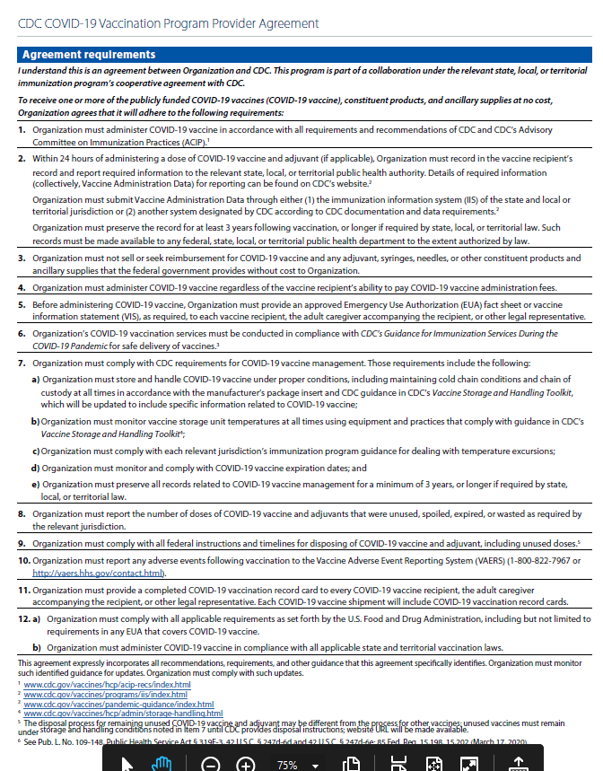
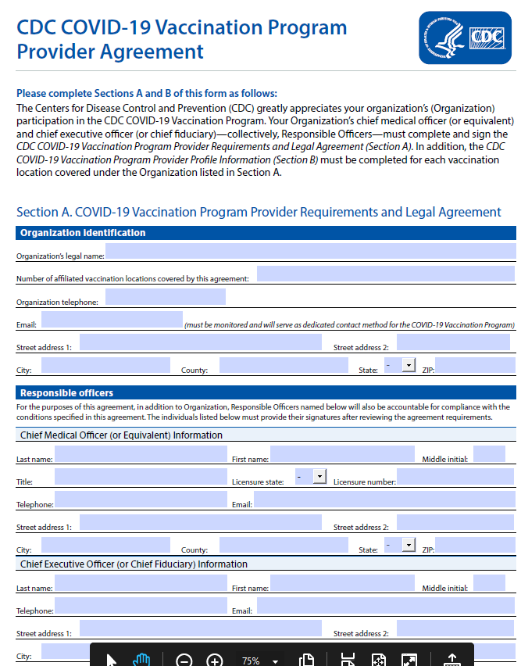
Enrollment Process
Action Steps & Instructions for Provider Enrollment
In order to receive and administer COVID-19 vaccines, all California healthcare providers will enroll in the federal COVID-19 Vaccination Program electronically through CDPH’s provider registration and enrollment system:
Sites provide key information for the organization and their respective individual clinic locations
Agree with participation terms outlined in the federal Provider Agreement
Completes required training elements
Provides population information
Acknowledges clinical and storage capacity to receive, store, and administer vaccine
Notes:
The Enrollment process includes a number of steps: providing key information, agreeing to federal provider agreements, completing training elements, providing population information, acknowledging storage and capacity.

Slide 36
Enrollment Process
COVIDReadi is a third-party application adopted by CA for the rapid enrollment of Phase 1 providers
Access is limited (link provided by LHDs or State) to likely immunizers of critical population identified for the phase (1 and 1b)
Notes:
We are using COVIDReadi to do enrollment.

Slide 37
Enrollment Process
Each person registers for their own account.
Email will need to be verified before adding information for the organization.
Once the Organization is established, an invitation code can be sent to others in the organization.
This facilitates getting signatures of both Chief Medical Officer and Chief Financial Officer, as well as adding individual locations.
Notes:
Every person needs to register for their own account and have their email verified before adding information. A great feature of the system is that you can send invitations to others in the organization to facilitate sign up.

Slide 38
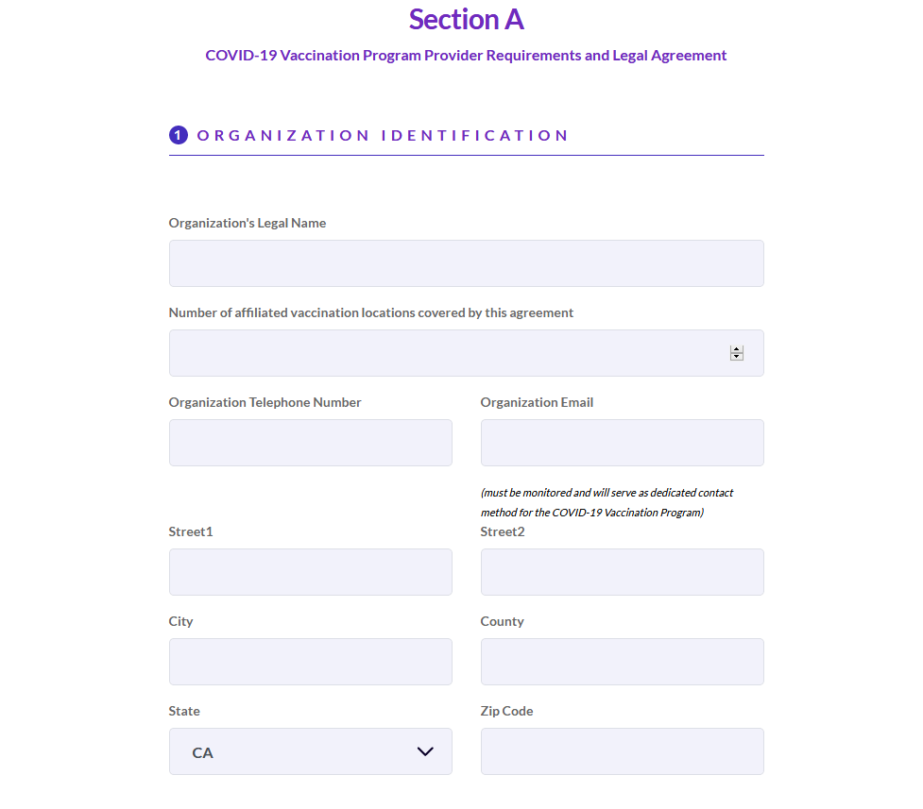
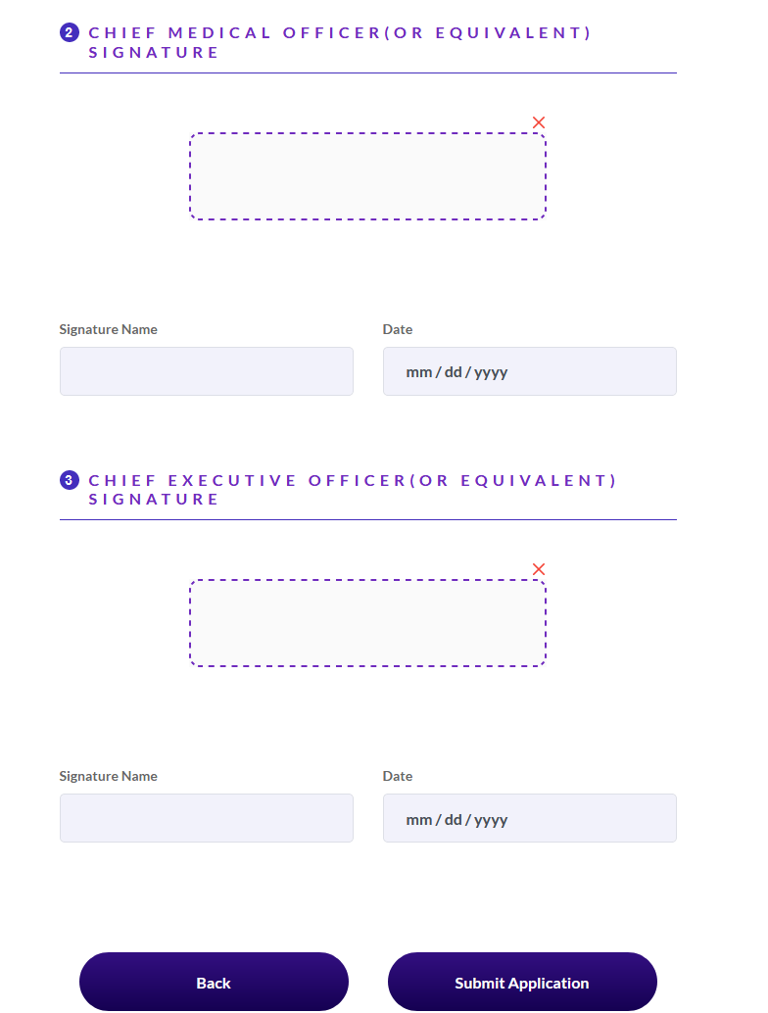
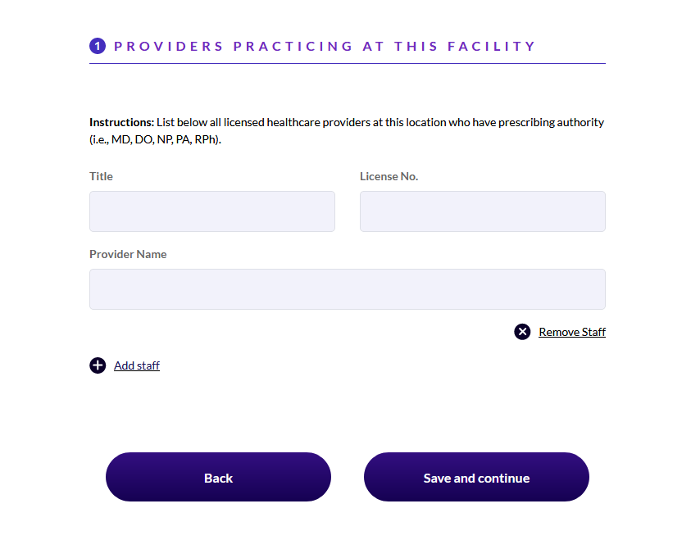
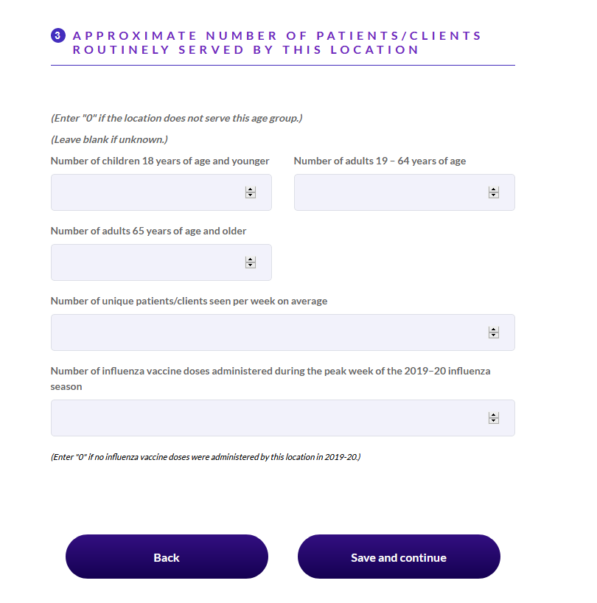
Enrollment Application Process
Sites provide key information for the organization and their respective individual clinic locations
Agree with participation terms outlined in the federal Provider Agreement
Completes required training elements
Provides population information
Acknowledges clinical and storage capacity to receive, store, and administer vaccine
Notes:
Here are a few screen shots of the system. Once the Chief Medical Officer and Chief Financial Officer have completed Section A and signed the agreement, then individual locations can be added. You will need to have information on populations served, peak influenza administration, and storage and handling capacity.

Slide 39
Enrollment Process
Upon submission of the registration through COVIDReadi, sites will receive a confirmation email confirming the request to enroll.
Registration information is sent to the Local Health Departments who will then be responsible for the allocation of available vaccine doses, pending supply availability.
Information about vaccine ordering will be forthcoming.

